Slide 1
Getting to Know the SWAMP (Software Assurance Marketplace)
Irene Landrum
Assistant Project Manager

Slide 2

What Is SWAMP?
The SWAMP, or Software Assurance Marketplace, is a no-cost resource available to the software community to promote a more stable and secure software ecosystem.
We currently host 16 static analysis tools to check your code for weaknesses.
Our results viewer, Code Dx, allows you to view the results from multiple tools in one place, making it easier to identify and address the most important problems in your code.
We support continuous software assurance, the practice of scheduling assessments of your code throughout the development lifecycle and whenever code changes are made.

Slide 3
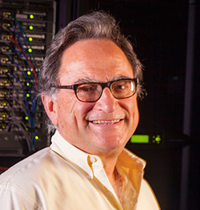



About Us
Operational since February 2014
Funded by a 5-year grant from the U.S. Department of Homeland Security
A joint effort of 4 research institutions:
Morgridge Institute for Research (infrastructure, user interface, testing)
University of Illinois Urbana-Champaign (identity management, testing)
University of Wisconsin-Madison (framework: tools, languages, platforms)
Indiana University (cybersecurity, 24/7 support)
Secure and dependable facility hosted at the Morgridge Institute for Research
Principal Investigators:
Miron Livny, MIR
Jim Basney, UIUC
Bart Miller, UW
Von Welch, IU

Slide 4
Software Assurance (SwA) Challenges
Cybersecurity is on everyone’s mind.
We immediately think about the network and the system (firewalls, software updates, etc.), but we should remember that this also includes the software itself!
The world is software-centric.
There are numerous entry points for a variety of attacks against confidential data and physical resources. Many software vulnerabilities and weaknesses exist while more continue to emerge.
Software developers need effective continuous software assurance capabilities to integrate into their development workflows.
Find and fix problems with your code, and check your code frequently!
Consumers of software components need services to evaluate the quality of the components they deploy or integrate into their software stack.
Challenges with software assessment tools:
Each tool has its strengths, but no single tool is good at everything.
Configuring, maintaining, and using tools is cumbersome and time-consuming.

Slide 5
Goals of the SWAMP
Simplify and automate the task of applying a broad spectrum of software analysis tools to software packages throughout the development lifecycle
Deliver assessment results to the user in a way that is easy to understand
Lower the obstacles to performing software security assessments
Provide a resource for organizations and open-source developers to institute software assurance practices
Promote continuous software assurance: “Do it early, and do it often.”
Foster more secure deployed software
Allow users to collaborate and share SwA products and methodologies
Serve as a testing and evaluation ground for new and mature software assurance tools and technologies

Slide 6
Welcome to the SWAMP
Support for 5 languages: C/C++, Java source, Java bytecode, Python, Ruby
Support for 10 platforms: 9 varieties of Linux plus Android
16 static software analysis tools are available for public use:
C/C++: Clang Static Analyzer, CppCheck, GCC warnings, Parasoft C/C++test
Java: Checkstyle, error-prone, FindBugs with Find Security Bugs, Parasoft Jtest, PMD
Python: Bandit, Flake8, Pylint
Android Lint
Ruby: Reek, RuboCop, ruby-lint
Agreements with 4 commercial tool vendors to add their tools:
C/C++test and Jtest (Parasoft) are available now
Code Sonar (GrammaTech), Goanna (Red Lizard), and SAST (Veracode) coming soon
400+ software packages are available for public use:
NIST Juliet and SATE test suites for C/C++ and Java
SWAMP curated packages
Supported platforms, tools, and packages are maintained by the SWAMP

Slide 7
Welcome to the SWAMP (continued)
The fully-integrated results viewer, CodeDx (Secure Decisions), consolidates and prioritizes vulnerabilities from multiple tools to significantly simplify remediation
Support for GitHub identities, uploading packages from repositories, and pulling packages from public repositories
Powerful high-throughput computing capabilities
Scheduling feature for automated continuous software assurance
Maintain confidentiality of software and results at the discretion of the user
Managed sharing of tools, software packages, and results
Audience:
Software Developers
Software Assurance Tool Developers
Software Assurance Tool Researchers
Infrastructure Operators
Educators and Students

Slide 8
Key Attributes
Highly automated
If you can compile your tool in the SWAMP, all else is automated.
Secure
Strong sandboxing: all executions in single-use virtual machines
Private (if you wish)
Share your tool, app, or data if and when you choose.
Open
Lots of tools, lots of apps, lots of assessment data
A resource
Software to help make your job easier; people to advise you
A community
Join and leverage other like-minded users online and in person.

Slide 9
What SWAMP Can Do for Developers
Automates building packages on SWAMP platforms
Automates assessing software packages in C/C++, Java, Python, or Ruby with tools in the SWAMP
Free access to commercial tools for open-source developers, students, & educators
Analyzes Results
View weakness results
View integrated multi-tool results from the same version of a package
Compare results between package versions
Inter-tool result viewing
Protects privacy of results
Support third-party assessments, so SWAMP can provide assurance evidence to acquirer

Slide 10
Run the Tools Early, Run Them Often
Build in assurance from day one, or the task becomes overwhelming for the programmer :
dthread.h: In constructor ‘ScopeLock::ScopeLock(Mutex&)’:
dthread.h:132: warning: unused variable ‘result’
dthread.h: In constructor ‘ScopeLock::ScopeLock(CondVar&)’:
dthread.h:140: warning: unused variable ‘result’
src/irpc.C: In member function ‘void int_iRPC::setState(int_iRPC::State)’:
src/irpc.C:118: warning: unused variable ‘old_state’
src/irpc.C:119: warning: unused variable ‘new_state’
src/irpc.C: In member function ‘bool int_iRPC::saveRPCState()’:
src/irpc.C:714: warning: unused variable ‘result’
src/irpc.C:723: warning: unused variable ‘result’
src/irpc.C:736: warning: unused variable ‘result’
src/irpc.C:1030: warning: unused variable ‘result’
src/irpc.C:1041: warning: unused variable ‘result’
src/irpc.C:1081: warning: unused variable ‘result’
dyninst/proccontrol/src/response.h:35,
dyninst/proccontrol/src/int_process.h:39,
dyninst/proccontrol/src/mailbox.C:33:
dthread.h: In constructor ‘ScopeLock::ScopeLock(Mutex&)’:
dthread.h:132: warning: unused variable ‘result’
dthread.h: In constructor ‘ScopeLock::ScopeLock(CondVar&)’:
dthread.h:140: warning: unused variable ‘result’

Slide 11
Continuous Assurance:
Do it Early and Do it Often

Slide 12
Open & Open-Source
OWASP member since 2013
GitHub: mirswamp
Managed as an open-source project
All software is developed under Apache license
No-cost software assurance resource
Integration of open-source software analysis tools and platforms
Active interaction with the community to identify trends, promote adoption, and collect feedback
User needs and input drive SWAMP development!

Slide 13
Long Term Vision
Support for a large variety of commercial and open-source static, binary, and dynamic analysis tools
Support for iOS, MacOSX, and Windows platforms
Support for a large number of programming languages
Integration with multiple code repositories
Automated scheduled software analysis of the latest code version in a public or private repository
Deployment of local/private SWAMP installations for sensitive software (SWAMP in a Box)
Plug-ins for IDEs: Eclipse, IntelliJ IDEA, BlueJ
SWAMP API

Slide 14
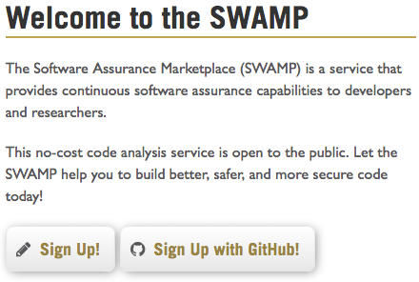
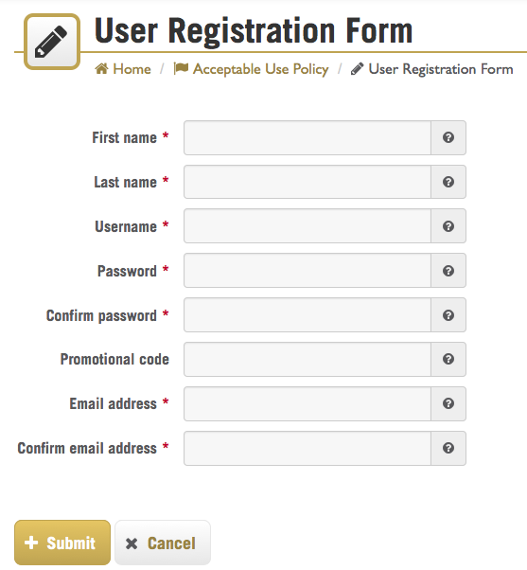
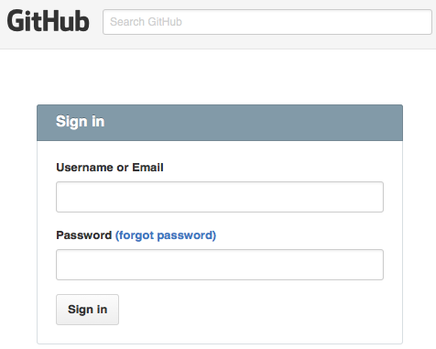
Tour

Slide 15
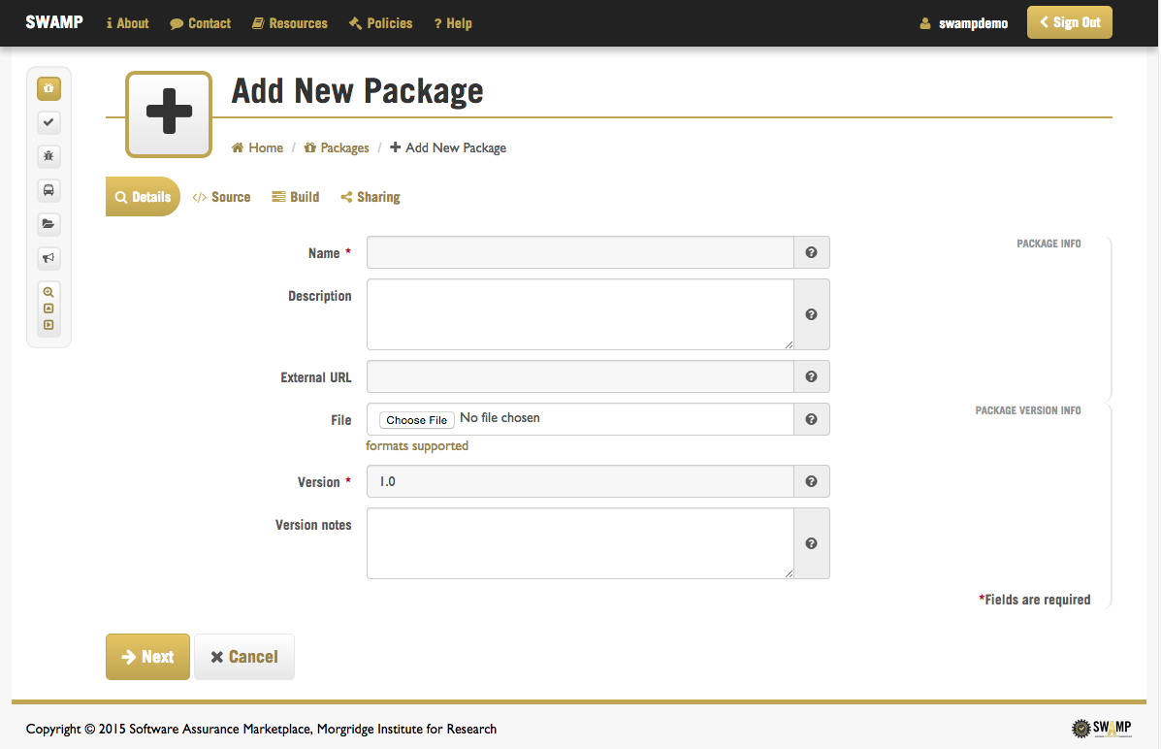
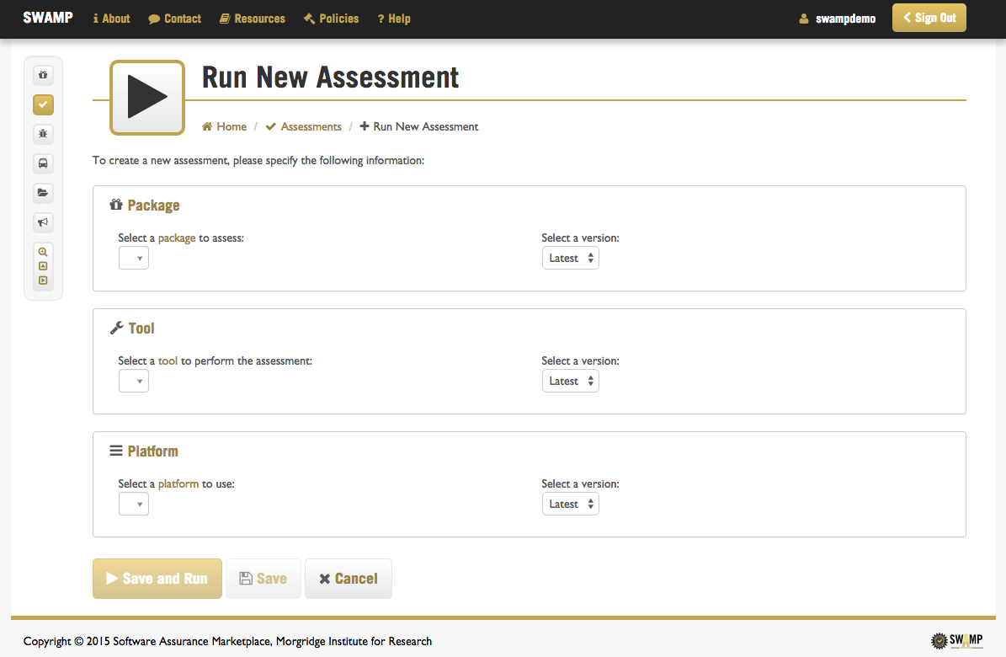
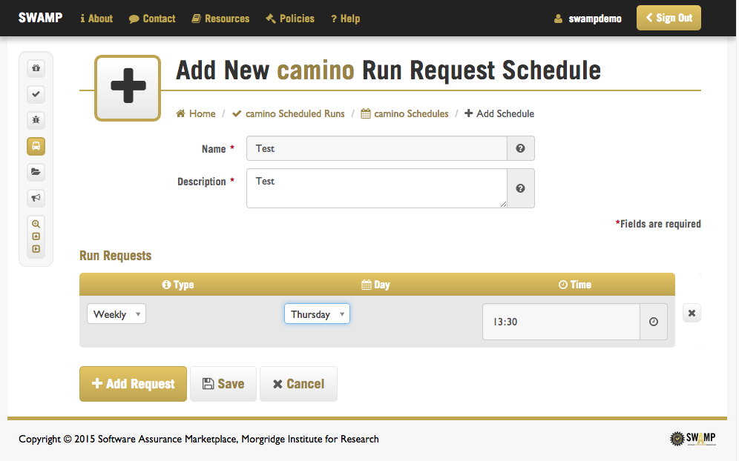
Tour

Slide 16
Tour

Slide 17
Contacts
Join the SWAMP at https://continuousassurance.org!
Assistant Project Manager, Irene Landrum
ilandrum@continuousassurance.org
General
swamp@continuousassurance.org
SWAMP 24/7 Support
support@continuousassurance.org
1+317-274-3942

Slide 18
Questions?
FAQs

